Slide 1
Minimizing UAPD Response Times
Stella Shipman, Sidney Gehring, and Kailey Phillips
1

Slide 2

Background
We chose to address an issue that directly affects our community and aimed to do something that could make a difference right where we are.
2

Slide 3
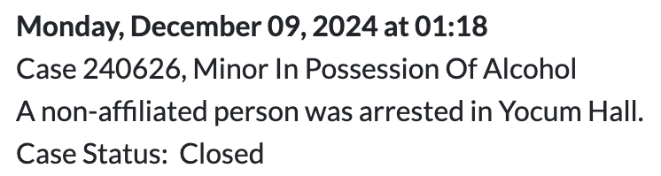

Data
Before:
After:
4

Slide 4
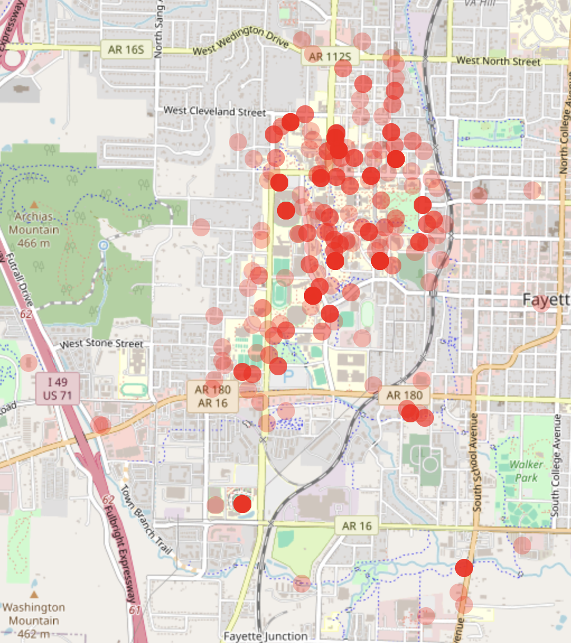
Mapping
We converted each location to latitude and longitude.
5

Slide 5
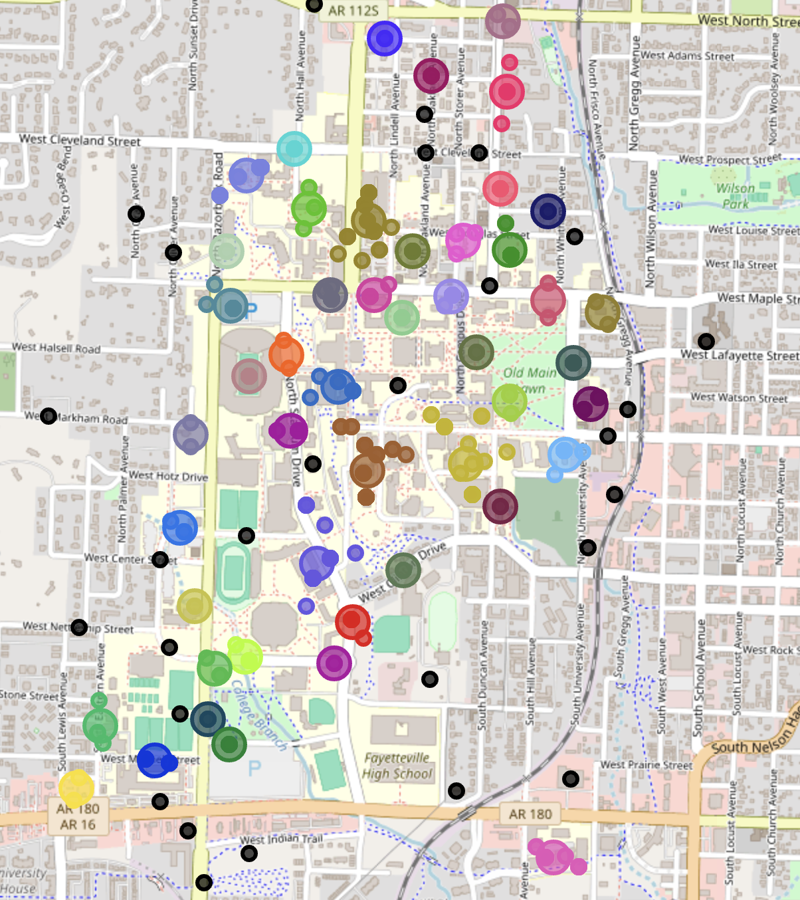
Crime Weight
Weight 5: Serious violent crimes
Weight 4: Major public safety or drug-related offenses
Weight 3: Moderate-level offenses Weight 2: Minor legal violations, traffic offenses, and underage possession of alcohol or tobacco
Weight 1: Non-criminal matters with minimal immediate threat
Crime weight: Average Crime Score per cluster x Number of incidents
6

Slide 6
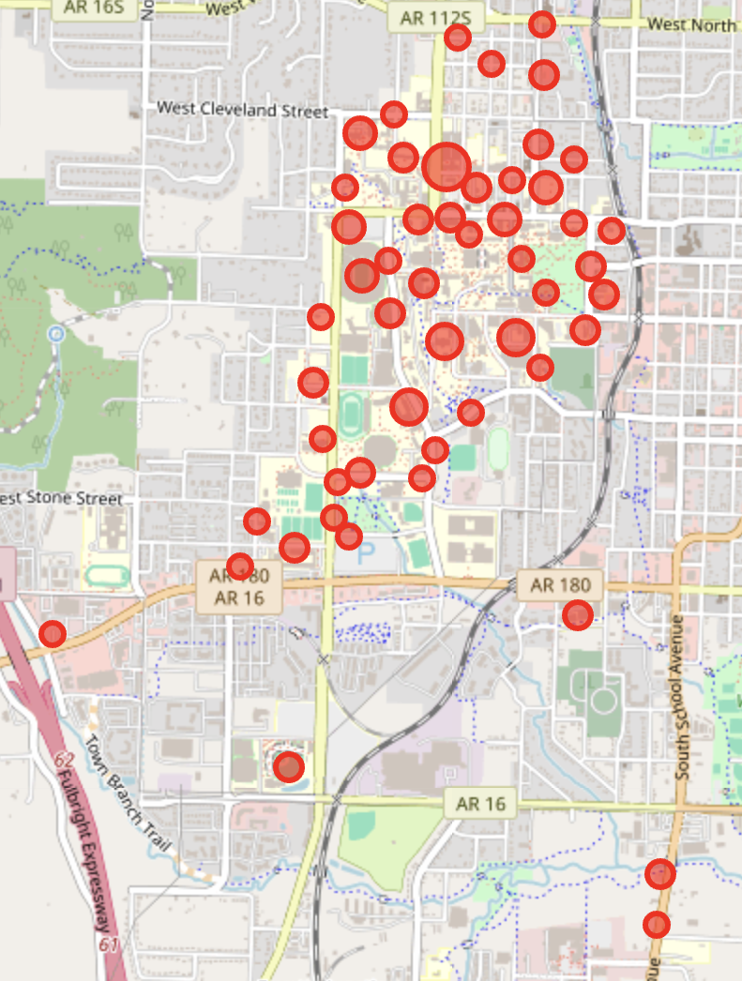
Crime Weight
Location of Cluster | Avg crime score | Incident count | Crime weight
Bookstore | 4.57 | 42 | 192
Pomfret | 4.54 | 24 | 109
Humphreys | 3.44 | 29 | 100
Lot 428 | 3.22 | 27 | 87
4

Slide 7
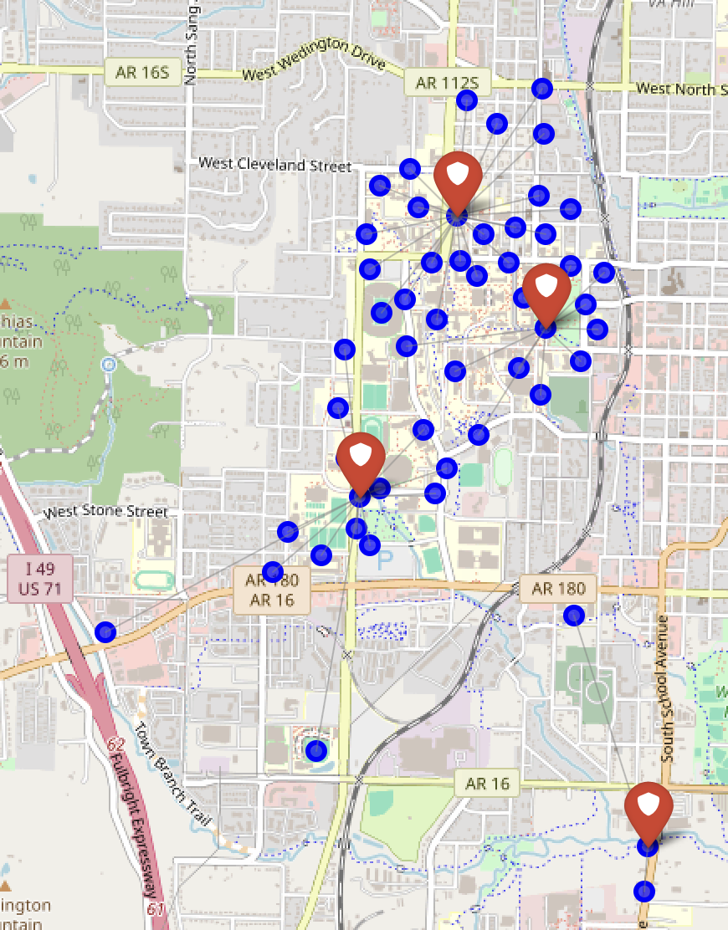
Final Model
Officers should be stationed at:
University Bookstore
White Engineering
Lot 314 (Across the street from intermural fields)
Mr. Taco Loco
Objective Value: 22833.14
7

Slide 8
Conclusion
We built a data driven optimization model to reduce police response times at the University of Arkansas. By converting messy crime reports into usable data, geocoding locations, and using clustering and Pyomo modeling, we found optimal officer placements based on crime severity and distance.
8

Slide 9
Takeaways
Clean data matters: Standardizing inconsistent entries was time-consuming but critical
AI helped: ChatGPT sped up data formatting, though manual checks were still needed
Clustering simplified analysis: 400+ incidents reduced to 52 core locations
Modeling takes trial and error: Pyomo required multiple tweaks to constraints and logic

Slide 10
Thanks!
Resources​:
https://uapd.uark.edu/about-us/police-services.php
https://uapd.uark.edu/reports-and-logs/daily-crime-log/2023.php
9

